Slide 1
Serverless Framework
https://serverless.com/
AWS

Slide 2
Setup
AWS CLI
https://aws.amazon.com/cli/
Serverless Framework CLI
https://serverless.com/cli/
https://serverless.com/framework/docs/getting-started/
NodeJS
https://nodejs.org/en/
https://github.com/nvm-sh/nvm

Slide 3
Introdução
Serverless?
Serverless Framework?

Slide 4
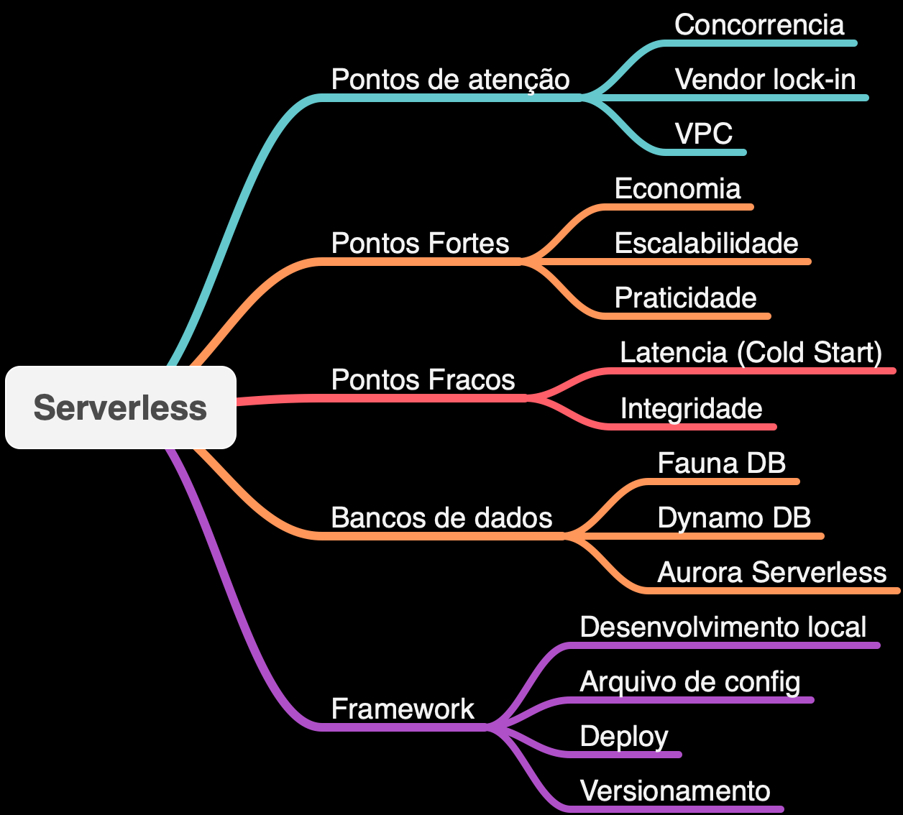

Slide 5
Code
Github
https://github.com/renatomattos2912/webinar-serverless-framework-aws

Slide 6
Fim

